Slide 1

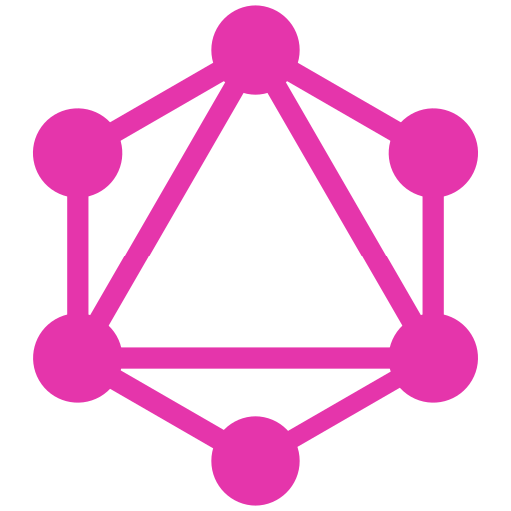

An intro into GraphQL and its implementation
By Heinrich Venter

Slide 2
What is GraphQL?
An open source specification created by Facebook in 2015, used to access data API's.
Consists of two parts
Consumer Client
Send queries to the service (Based on GraphQL query specifications)
Runtime on API service
Process queries sent to the service from clients
GraphQL has schema's and no models or controllers
Schema declares what consumers can access on the service

Slide 3
What makes GraphQL so powerful?
Gives the client the power to specify the exact fields they need and its structure.
The playground UI helps with documenting your API service.
The playground UI has an intuitive IntelliSense to assist in implementation & testing phases.
Combine multiple data sources into its related schema's
Assists the consumer to focus on the data and its format and not where its coming from.
So where am I going with this..?

Slide 4
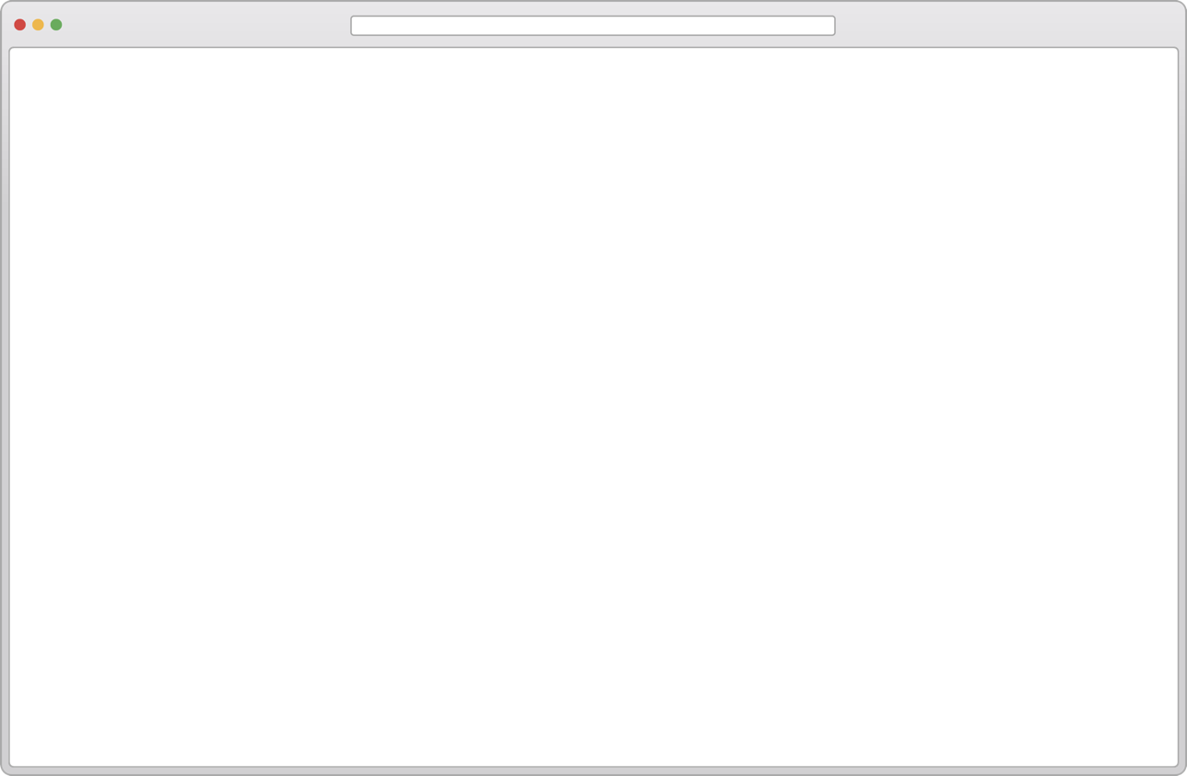
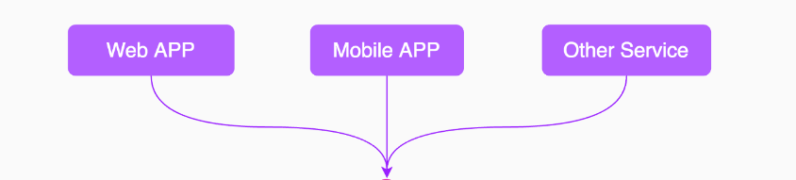
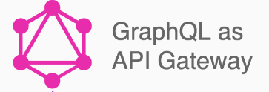
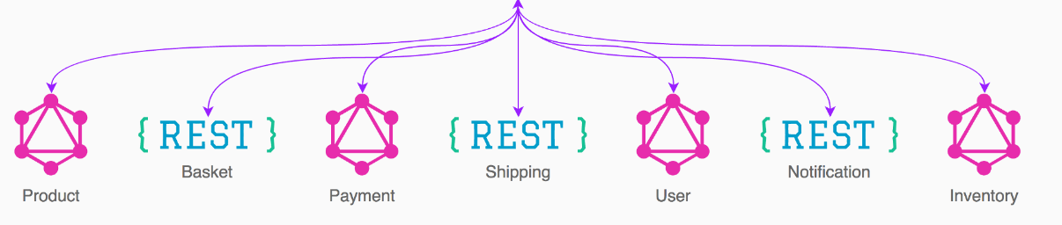
Multiple Clients
Multiple Schema Requirements
Multiple Sources
One GraphQL API Gateway

Slide 5
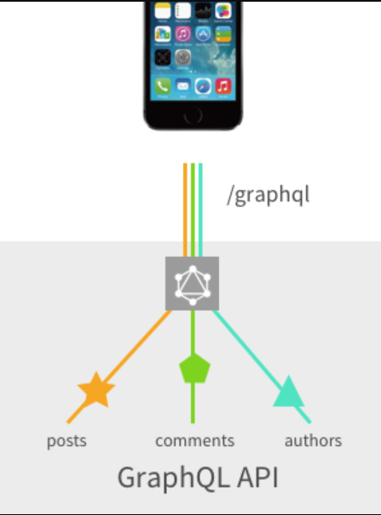
Let's Build the API
Using the implementation for .NET Core as an example.

Slide 6
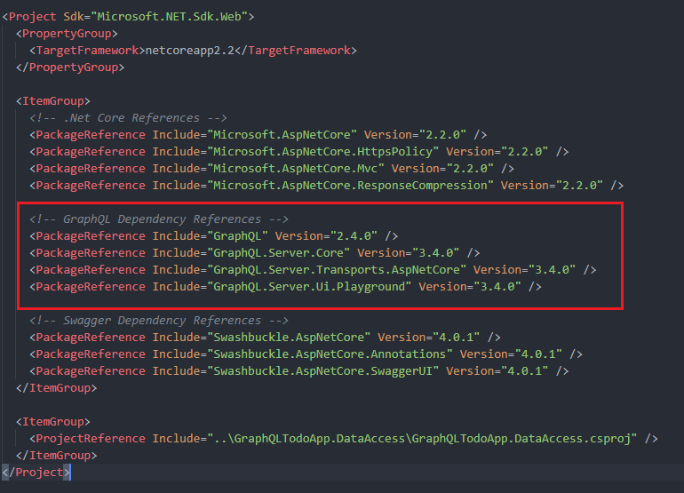
Lets add some references
To get GraphQL up and running we are going to install the next four references with the .NET CLI:
GraphQL for .NET
dotnet add package GraphQL
GraphQL Server Core
dotnet add package GraphQL.Server.Core
HTTP Middleware for GraphQL
dotnet add package GraphQL.Server.Transports.AspNetCore
GraphQL Playground Extension
dotnet add package GraphQL.Server.Ui.Playground

Slide 7
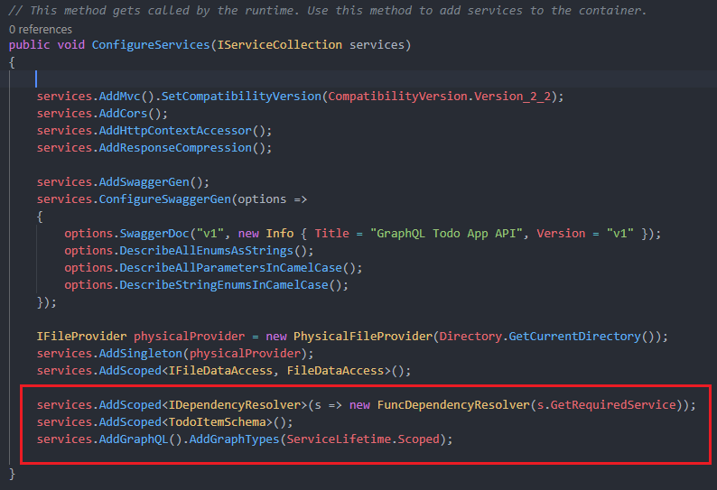
Configure GraphQL Services in the Startup
At this stage we need to configure GraphQL
Add the GraphQL.IDependencyResolver interface as a scoped service.
We will cover schema's a bit later but register your TodoItemSchema as a scoped service for now.
Use the AddGraphQL extension method to add the required GraphQL services and afterwards the AddGraphTypes extension to register all of GraphQL's types.

Slide 8
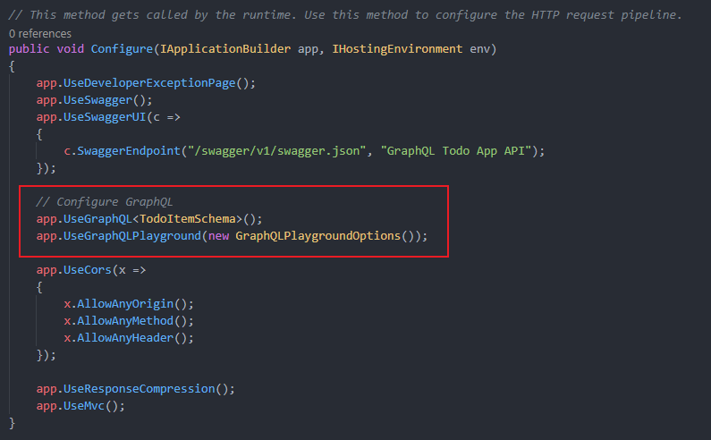
Add the GraphQL Middleware & Playground UI
Lets add GraphQL to our pipeline
Tell our .Net Core API to use the TodoItemSchema with GraphQL
Call UseGraphQLPlayground to tell our .Net Core API to add the Playground UI

Slide 9
Implementing our GraphQL
Schema's & CustomGraphTypes

Slide 10
Testing our GraphQL service with the Playground UI
https://fb-devc-graphqltodoapp.azurewebsites.net/ui/playground

Slide 11
Questions?

Slide 12
Thank You For Your Time!

